Slide 1
LASSO REGRESSION
GROUP 3: MAUREEN, MELVIN & ROSE

Slide 2
1. INTRODUCTION
LASSO Least Absolute Shrinkage and Selection Operator.
Is a form of regularization for linear regression models. Regularization is a statistical method to reduce errors caused by overfitting on training data.
It is used for feature selection since it shrinks parameters associated with less important variables to zero.
Why Lasso?
It is frequently used in machine learning to handle high dimensional data as it facilitates automatic feature selection with its application. It does this by adding a penalty term to the residual sum of squares (RSS), which is then multiplied by the regularization parameter (lambda or λ). This regularization parameter controls the amount of regularization applied. Larger values of lambda increase the penalty, shrinking more of the coefficients towards zero; this subsequently reduces the importance of (or altogether eliminates) some of the features from the model, resulting in automatic feature selection. Conversely, smaller values of lambda reduce the effect of the penalty, retaining more features within the model.

Slide 3
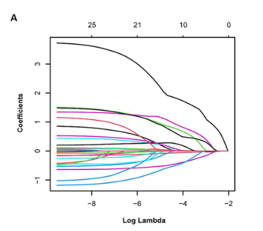

Slide 4
3.TERMS USED.
R squared (R^2) : Measure of how well the model explains the variability of the dependent variable. Ranges from 0 to 1.Model explains none or all.
Sum of squared errors(SSE)/Sum of squared residuals(SSR): It quantifies the discrepancy between the observed value and the values predicted by the model. Minimizing SSR is crucial for achieving a more accurate and reliable model.
RSS = Σ(yi – ŷi)^2
Multicollinearity : Situation where 2 or more independent variables are highly correlated. It provides redundant information about the variance in the dependent variable. Use VIF function() in R. Above 5 there is multicollinearity the issue needs to be addressed.
Shrinkage penalties are techniques used in statistical modeling, particularly in regression, to prevent overfitting by constraining the model parameters. They add a penalty term to the loss function, which effectively "shrinks" the estimates of the coefficients toward zero or other specified values. This can lead to simpler, more interpretable models while potentially improving predictive performance on new data.

Slide 5
Lasso Regression L1 penalty
The Lasso regression modifies the loss function by adding a penalty term that is proportional to the sum of the absolute values of the coefficients:
Loss Function = RSS + λ Σ |β_{j}|
where j ranges from 1 to p and λ ≥ 0.Approaches infinity shrinkage penalty becomes more influential..
The term ∑ j=1 to p ​∣βj​∣ sums the absolute values of all coefficients thus applying the L1 penalty across all predictors in the model.
The L1 penalty encourages sparsity in the coefficient estimates, meaning that some coefficients may be exactly zero. This leads to variable selection, where irrelevant features are effectively excluded from the model.

Slide 6
BIAS VARIANCE TRADE OFF.
The basic idea of lasso regression is to introduce a little bias so that the variance can be substantially reduced, which leads to a lower overall MSE.
Lamda which is the tuning/regulization parameter sets the strengths of the penalty.
Bias-Variance Tradeoff in Lasso
High Bias (Underfitting):
If λis too large, Lasso imposes a strong penalty, leading to many coefficients being shrunk to zero. This can result in a model that is too simplistic, missing important relationships in the data (underfitting).
The model may have high bias because it fails to capture the complexity of the true underlying data distribution.
High Variance (Overfitting):
Conversely, if λ is too small, Lasso allows more coefficients to retain their values, potentially fitting the noise in the training data. This can lead to overfitting, where the model captures random fluctuations rather than the underlying trends.
In this case, the model has high variance and may perform poorly on unseen data.
There is need to find balance so as to find the right lamda. Optimal Lamda.

Slide 7
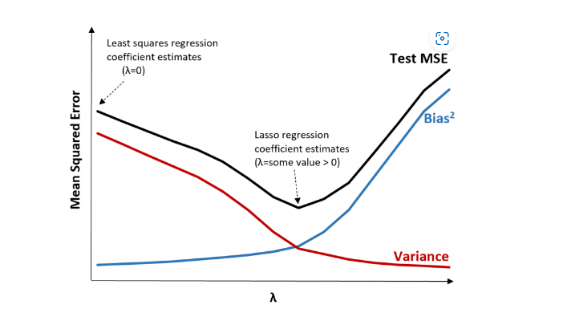
This means the model fit by lasso regression will produce smaller test errors

Slide 8
2.Applications of lasso regression.
Lasso regression is particularly useful in situations where the number of predictors is largely relative to the number of observations.(High dimensionality)

Slide 9
Economics: Economists apply lasso regression in models where they need to estimate the effects of multiple variables on economic outcomes while simplifying models for better interpretability
Health Sciences: In clinical research, lasso regression helps in identifying significant predictors from a multitude of patient characteristics, aiding in risk stratification and treatment decision-making.
Environmental Studies: Lasso regression can be used to identify significant environmental predictors affecting ecological outcomes, such as species distribution or pollution levels.
Image Processing: In computer vision, lasso regression can be applied for feature selection in image classification tasks, aiding in identifying important features that contribute to object recognition.
Genomics: In genomic studies, lasso regression is used to identify relevant genes that are associated with diseases while handling high-dimensional data where the number of predictors can far exceed the number of observations.
Finance: Lasso is used in financial modeling to select significant predictors from a large set of financial indicators, helping in risk assessment and asset pricing.

Slide 10
COMPUTATION OF LASSO REGRESSION
Step 1: Calculate the correlation matrix and VIF values for the predictor variables.
If we detect high correlation between predictor variables and high VIF value then lasso regression is likely appropriate to use.
However, if there is no multicollinearity present in the data then there may be no need to perform lasso regression in the first place. Instead, we can perform ordinary least squares regression.
Step 2: Fit the lasso regression model and choose a value for λ.
Once we determine that lasso regression is appropriate to use, we can fit the model using the optimal value for λ.
To determine the optimal value for λ, we can fit several models using different values for λ and choose λ to be the value that produces the lowest test MSE.
Lastly, we can compare our lasso regression model to a ridge regression model and least squares regression model to determine which model produces the lowest test MSE by using k-fold cross-validation.

Slide 11
R CODES
NB:
Standardizing the predictors, also known as normalization or z-score normalization, transforms the variables so that they all have a mean of zero and a standard deviation of one. This process ensures that all predictors are on the same scale, which is particularly important in some statistical and machine learning algorithms.

Slide 12
Feature
Linear Regression
Ridge Regression
Lasso Regression
Objective
Minimize sum of
Minimize sum of
Minimize sum of
squared residuals
squared residuals
squared residuals
(no regularization)
with L2
with L1
regularization
regularization
Mathematical
Σ(yi – ŷi)^2
Σ(yi – ŷi)^2+λ Σ β_{j}
^2
Σ(yi – ŷi)^2+λ Σ |β_{j}|
Formula
Regularization Type
None
L2 regularization
L1 regularization
(shrinks coefficients
(shrinks and selects
but keeps all)
some coefficients to
be zero)
Feature Selection
No
No
Yes (automatically
selects important
features)

Slide 15
ADVANTAGES OF LASSO REGRESSION
Feature Selection: Lasso can shrink some coefficients to zero, effectively selecting a simpler model by excluding less important features.
Prevent Overfitting: The regularization term helps to prevent overfitting, especially in high-dimensional datasets. High dimensional datasets-A dataset is considered high-dimensional when the number of predictor variables is much larger than the number of observations. Lasso regression prevents overfitting by introducing a regularization term that penalizes complex models, automatically selects relevant features, and helps maintain a favorable bias-variance trade-off.
Simplicity: The resulting model is often easier to interpret due to fewer variables being retained.
Works Well with High-Dimensional Data: Lasso is particularly useful when the number of predictors exceeds the number of observations.

Slide 16
DISADVANTAGES OF LASSO REGRESSION.
1.Bias in Coefficients: Lasso can introduce bias in coefficient estimates because of the shrinkage, which may affect predictions. Even though it is effective in preventing overfitting and simplifying models, it introduces bias in coefficient estimates due to the shrinkage effect. This bias can impact the accuracy of predictions and interpretations of the model.
2. Not Suitable for All Data: It assumes a linear relationship; if the true relationship is non-linear, Lasso may perform poorly unless features are properly transformed. Can cause underfitting and biasness
3. Limited to Linear Models: While it can be adapted for other models, its primary formulation is based on linear regression, which may not capture complex patterns. This is by penalizing large coefficients.
4. Variable Selection Instability: In cases of high multicollinearity, Lasso may select different variables depending on small changes in the data.

Slide 17
CASE STUDY
Real estate firm: Zillow
Predicting property prices: In real estate, Lasso regression is used to analyze features like square footage, number of bedrooms, location, and amenities. By identifying the most influential factors, real estate agents can set competitive prices and guide buyers effectively. It can identify this through feature selection which simplifies the model
LINKS TO FURTHER EXPLAIN REGRESSION
https://youtu.be/NGf0voTMlcs?si=_hhOCjQS-1bLos3O
https://www.geeksforgeeks.org/lasso-regression-in-r-programming/
https://www.ibm.com/topics/lasso-regression#:~:text=Lasso%20regression%20is%20a%20regularization,the%20accuracy%20of%20statistical%20models

Slide 18
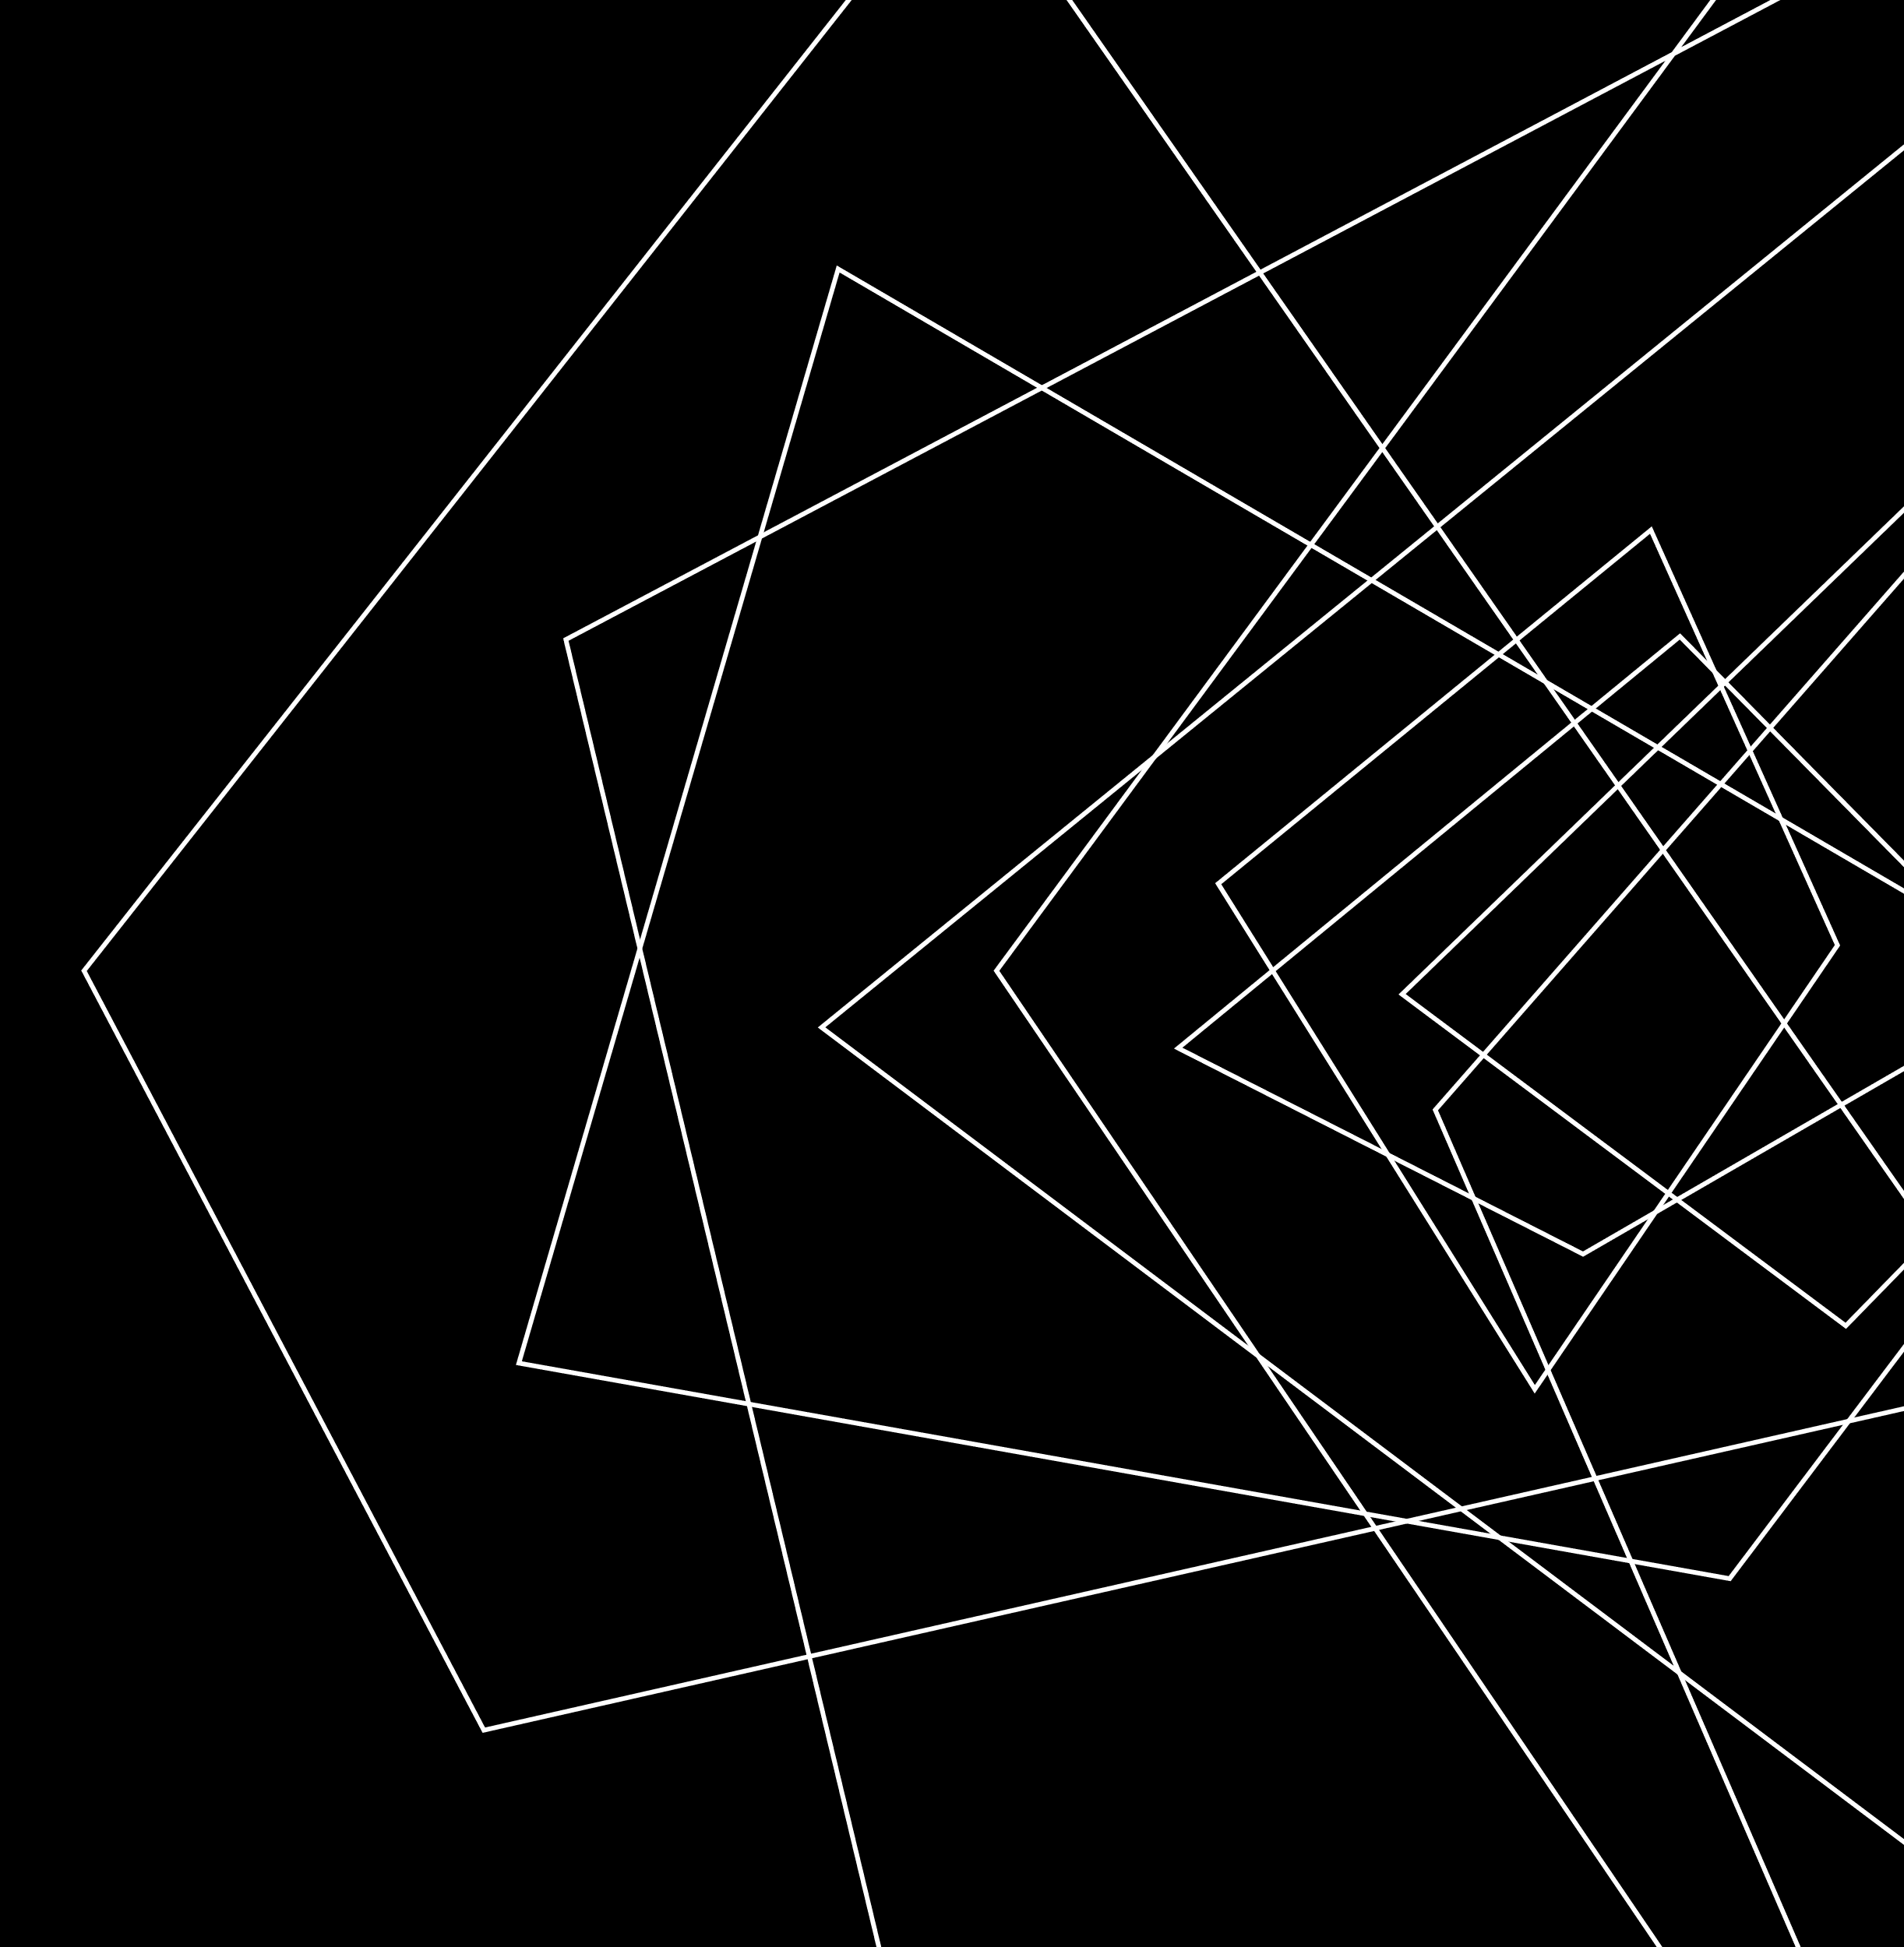
Thank you

